Slide 1
Préparation de la Ceinture Noire
Les Techniques au programme
Cyrielle Mingot
Décembre 2019

Slide 2

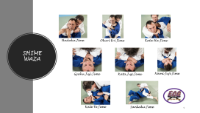
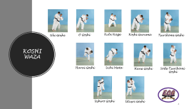
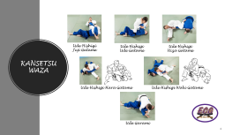
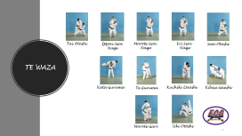
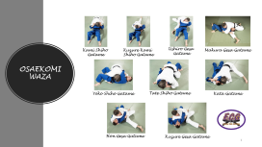
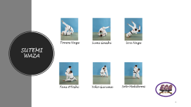
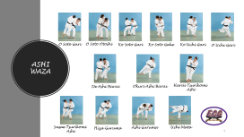
Sommaire

Slide 3




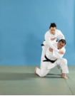





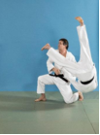
TE WAZA
Tai Otoshi
Ippon Seoi
Nage
Morote Seoi
Nage
Eri Seoi
Nage
Seoi Otoshi
Kata Guruma
Te Guruma
Kuchiki Daoshi
Kibisu Gaeshi
Morote Gari
Uki Otoshi

Slide 4



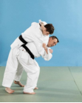

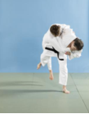
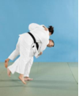


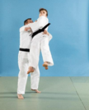

KOSHI WAZA
Uki Goshi
O Goshi
Kubi Nage
Koshi Guruma
Tsurikomi Goshi
Harai Goshi
Uchi Mata
Hane Goshi
Sode Tsurikomi
Goshi
Ushiro Goshi
Utusri Goshi

Slide 5
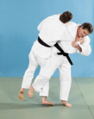

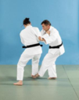

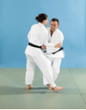


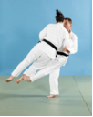
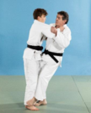
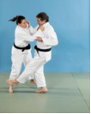
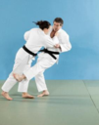


ASHI WAZA
O Soto Gari
O Soto Otoshi
Ko Soto Gari
Ko Soto Gake
Ko Uchi Gari
O Uchi Gari
De Ashi Barai
Okuri Ashi Barai
Harai Tsurikomi
Ashi
Sasae Tsurikomi
Ashi
Hiza Guruma
Ashi Guruma
Uchi Mata

Slide 6
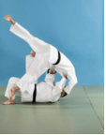
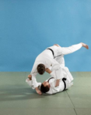
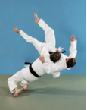
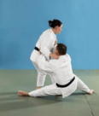
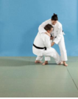
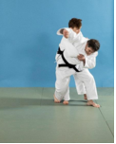
SUTEMI WAZA
Tomoe Nage
Sumi Gaeshi
Ura Nage
Tani OToshi
Yoko Guruma
Soto Makikomi

Slide 7
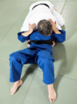
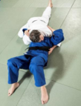
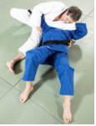
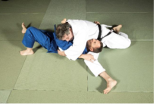
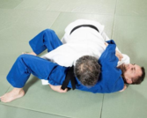
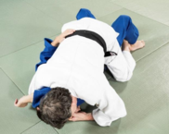
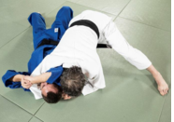
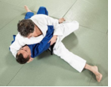
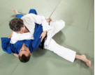
OSAEKOMI WAZA
Kami Shiho
Gatame
Kuzure Kami
Shiho Gatame
Ushiro Gesa
Gatame
Makura Gesa Gatame
Yoko Shiho Gatame
Tate Shiho Gatame
Kata Gatame
Hon Gesa Gatame
Kuzure Gesa Gatame

Slide 8
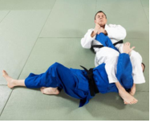
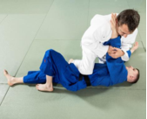
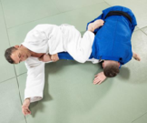
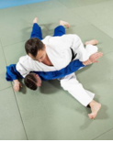
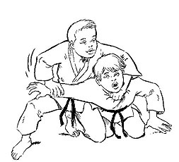
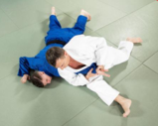
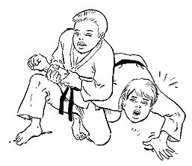
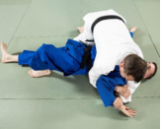
KANSETSU WAZA
Ude Hishigi
Juji Gatame
Ude Hishigi
Ude Gatame
Ude Hishigi
Hiza Gatame
Ude Hishigi Hara Gatame
Ude Hishigi Waki Gatame
Ude Garami

Slide 9
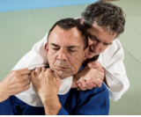
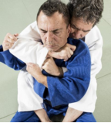
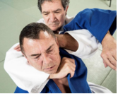
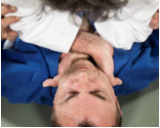
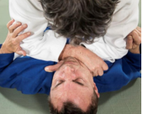
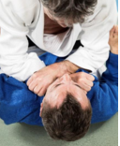
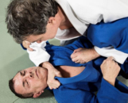

SHIME WAZA
Hadaka Jime
Okuri Eri Jime
Kata Ha Jime
Gyaku Juji Jime
Kata Juji Jime
Nami Juji Jime
Kate Te Jime
Sankaku Jime

